Slide 1
E-Medicare
RLL Project - Group 01

Slide 2
Team Members :
Github Link: https://github.com/RLL-Project/e-Medicare.git
Akanksha Patwa
Anand Kumar Jha
Abhinav Bhardwaj
Angina Durga Srivalli
Abinaya R
Ashish Kumar
Ahammed Fayas T L
Ashish Tarkeshwar SIngh
Abarna Arumugam
Ayya jothi Prakash

Slide 3
Abstract
The purpose of E-Medicare application is to automate the existing manual system by the help of computerized equipment's and full-fledged computer software, fulfilling their requirements, so that their valuable data can be stored for a longer period with easy accessing and manipulation of the same.
E-Medicare System, as described above, can lead to error free, secure, reliable and fast management system.
It also provides the time and effort exerted by the staff and ensures the accuracy of the patient's internal medical disbursement as well as the control of the disbursed quantities.

Slide 4
Introduction
The main aim of this project is to develop an online web portal that can handle Medicine booking. In recent times, mobile healthcare apps become more trending due to pandemic crisis. People are reluctant to leave their home in the aftermath of the coronavirus epidemic to purchase even basic commodities. Online medicine delivery apps allow for delivery at your doorstep.
In this, users can choose a medicine section of their choices and go through all the items that the system provides. Users can then select the desired drug items, add them to cart and then proceed to payment.
Our system solves the problems of going for searching medicines and saves transport cost.We are ensuring a fast delivery system which is safe and reliable. Customers can save both time and money.

Slide 5
Proposed System
The proposed medical Booking Store System will completely Revolutionize the industry.
Searching of products, order placing, billing and product stock can be maintained by a single click.
The payment of the order can also be done by credit cards

Slide 6
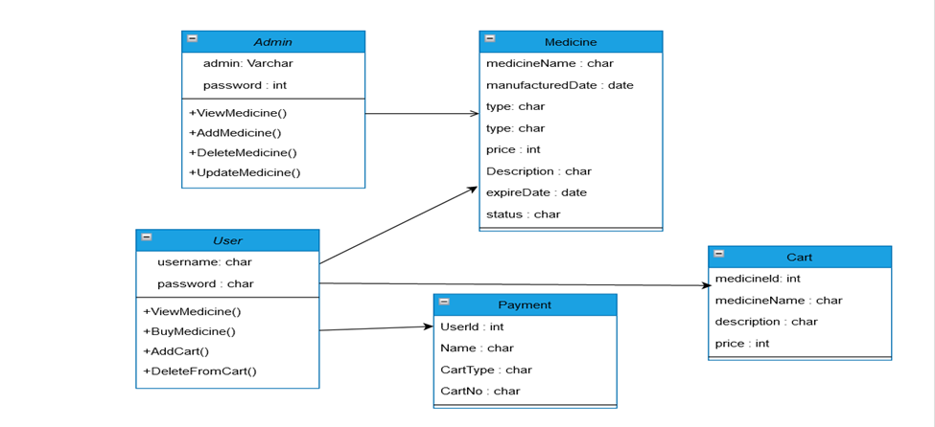
Entity Relationship Diagram
MedicineName : char
Price of product : int

Slide 7
Technology Used
HTML : Page layout has been designed in HTML.
CSS : CSS has been used for all the designing part.
Java : All the business logic has been written in Java.
Angular CLI : Command-line interface tool that we use to initialize.
MySQL : MySQL database has been used as database for the project.
Hibernate : Used for object-table mapping.
Spring-boot : Server side setup.
Tomcat : Server.

Slide 8
System Overview:
The “E-Medicare” should support basic functionalities for all below listed users
Login Module: Used for managing the login details.
Users Module: Used for managing the users of the system.
Admin Module: Used for managing. medicine details and user information.
Medicine Module: Used for managing the Medicine details.
Contact_us: Used if customer is having complaints.
Cart Module: Used for managing the details of Cart.
Payment Module: Used for managing the details of Payment. add update module…

Slide 9
Authentication & Authorization
Authentication:
Any end-user should be authenticated using a unique username and password.
Authorization:
The operations supported and allowed would be based on the user type. For example,Administrator has the rights to add product information and view customer details. He can also view order detail and purchase details of a medicines. Whereas User/Buyer has a right to Add, Remove and Clear all the products from cart

Slide 10
Functional Flow
Admin
DES Application
HTTP /GET
HTTP Response
Database
User
GUI
Server

Slide 11
Environment
Server – Apache Tomcat 8.5
Database – MySQL
My SQL J Connector
Node Version 10
Angular CLI
JDK 1.8
Eclipse IDE or Spring Tool Suite

Slide 12
UML Diagram
UML, short for Unified Modeling Language
It is a standardized modeling language consisting of an integrated set of diagrams, developed to help system and software developers for specifying, visualizing, constructing, and documenting the artifacts of software systems, as well as for business modeling and other non-software systems.
The UML is a very important part of developing object oriented software and the software development process.
The UML uses mostly graphical notations to express the design of software projects.

Slide 13
Case Diagram
Add/Delete/Update
Medicine details
View all Medicines and
Own cart Medicines
Admin
User
Purchase Medicines
View all Medicines and
Users

Slide 14
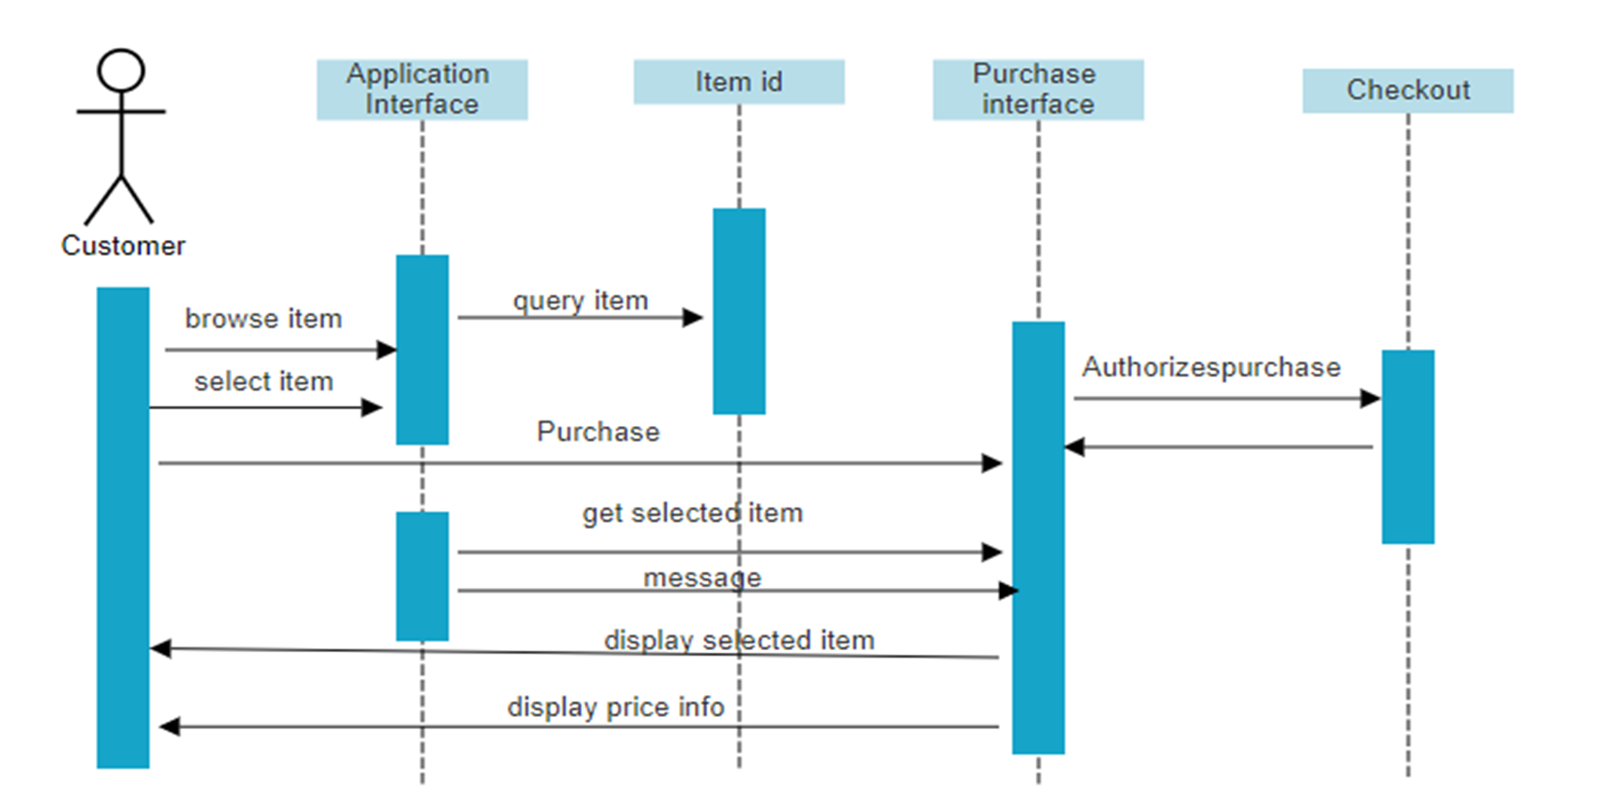
Sequence Diagram

Slide 15
Unit Testing:
JUnit is a unit testing framework for Java programming language. It plays a crucial role test-driven development, and is a family of unit testing frameworks collectively known as xUnit.
Features of JUnit:· J
Unit is an open source framework, which is used for writing and running tests.
Provides annotations to identify test methods.
Provides assertions for testing expected results.

Slide 16
Advantages
• Cost efficient.
• Easy Secured payments.
• User can view different categories of product of different pharma company .
• Saves Money.
• Diminishes Medical Wastes.
• Delivery drug stores accomplish greater accuracy more than the local store.

Slide 17
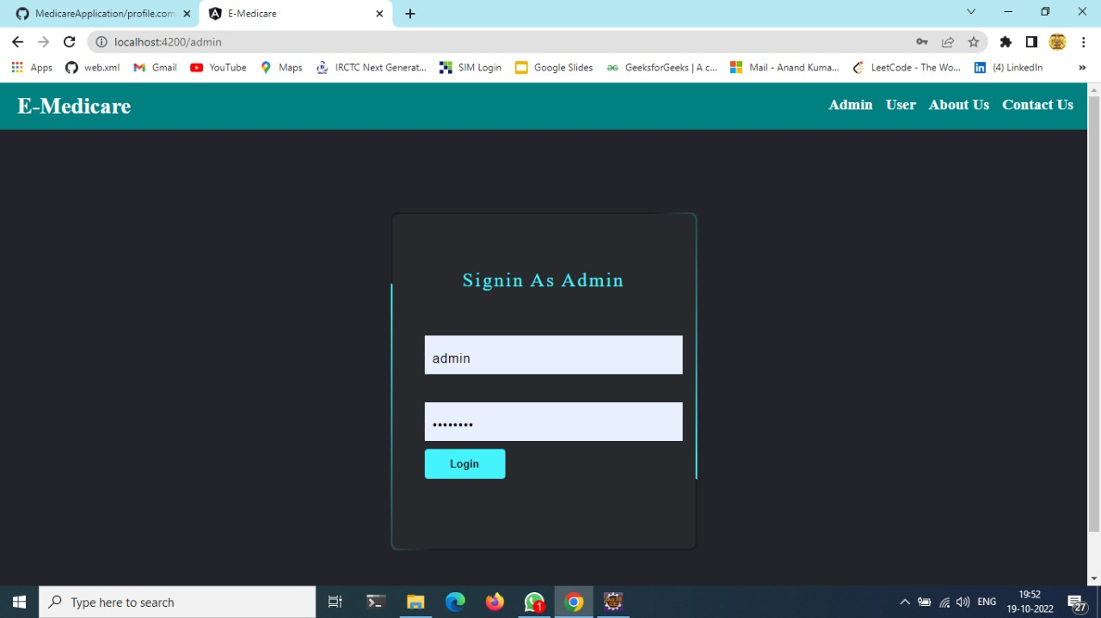
Output Screenshots
Admin Login

Slide 18
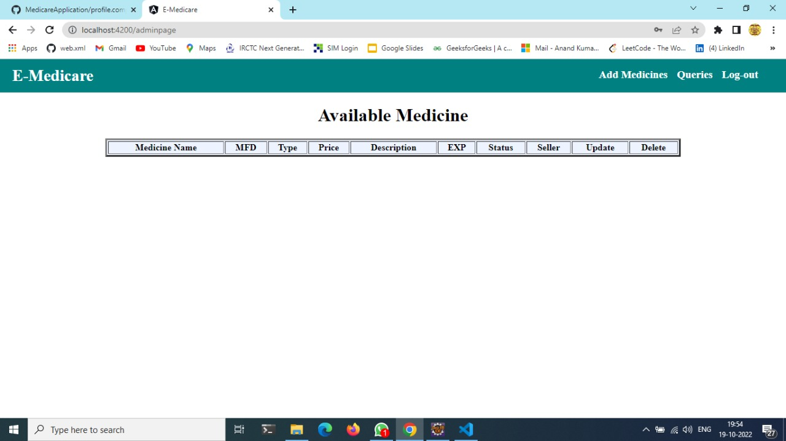
Admin Dashboard

Slide 19
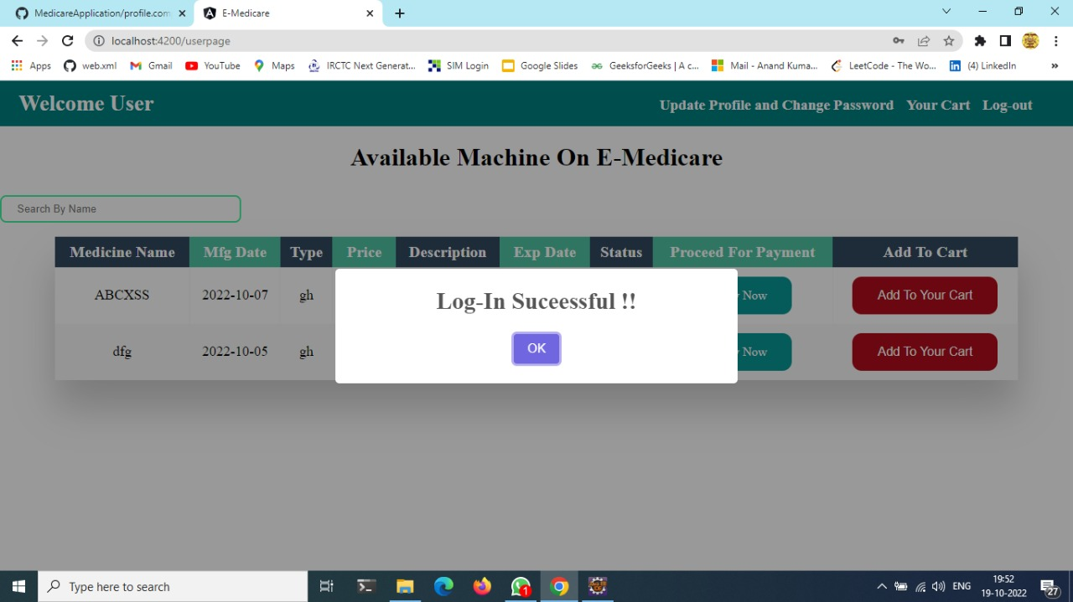
Admin Login Success

Slide 20
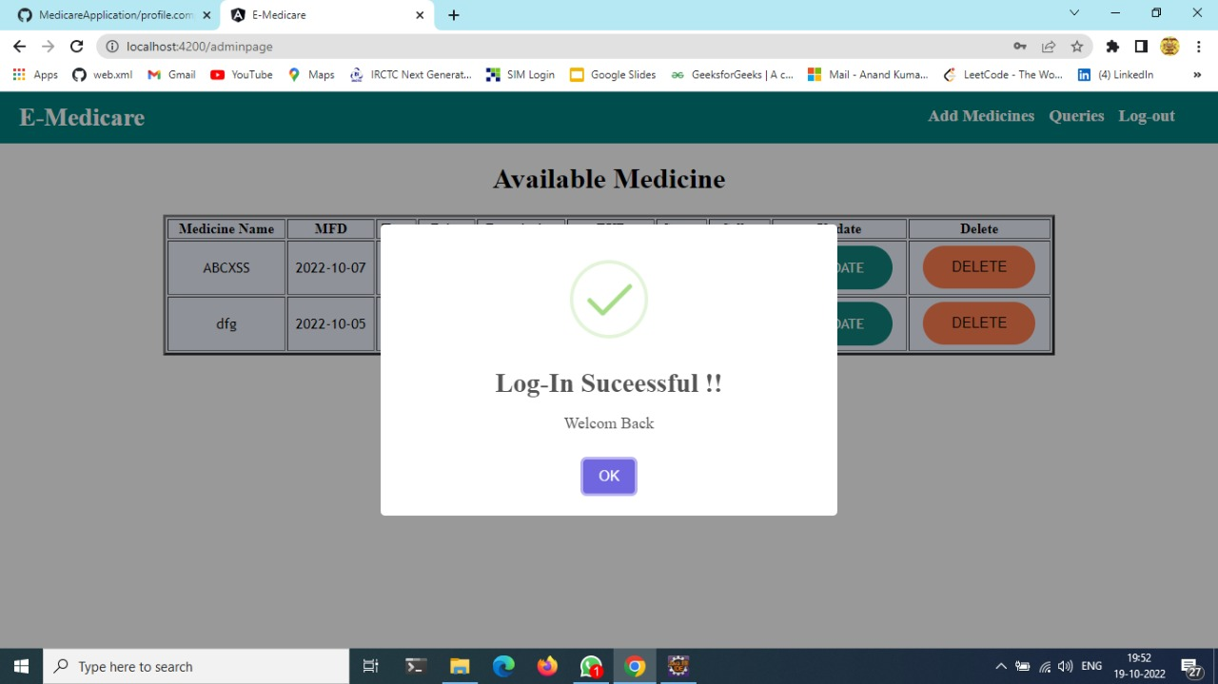
Output Screenshots

Slide 21
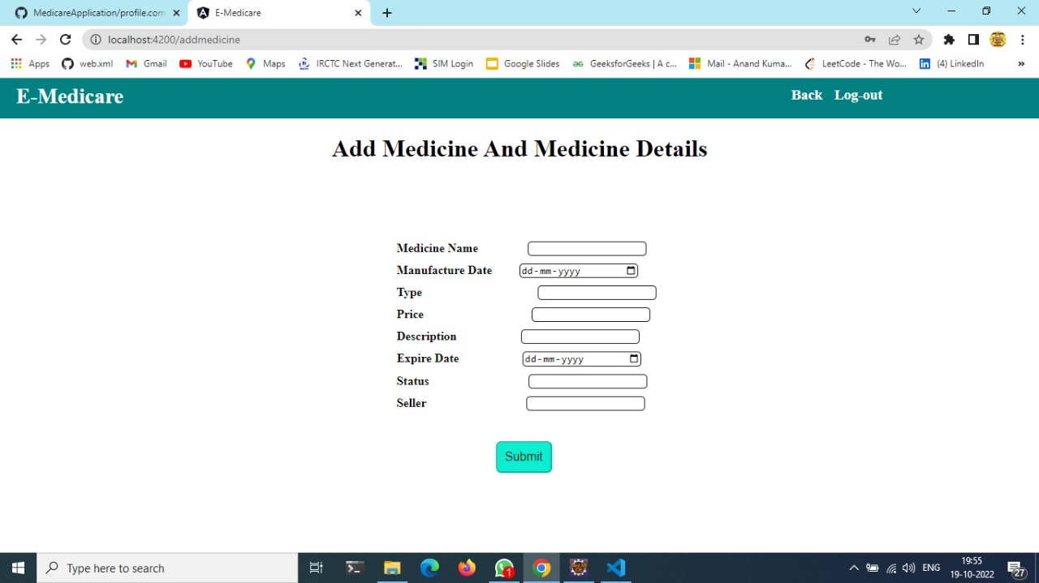
Add Medicine

Slide 22
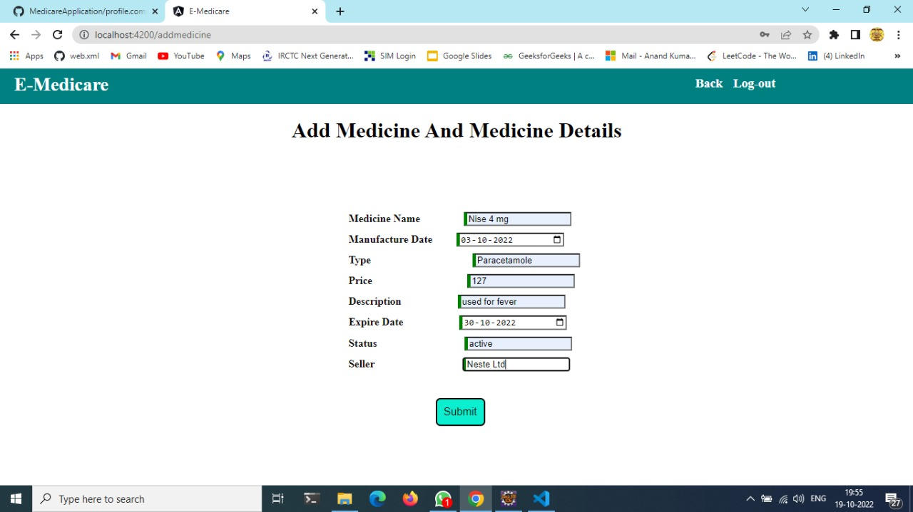
Output Screenshots

Slide 23
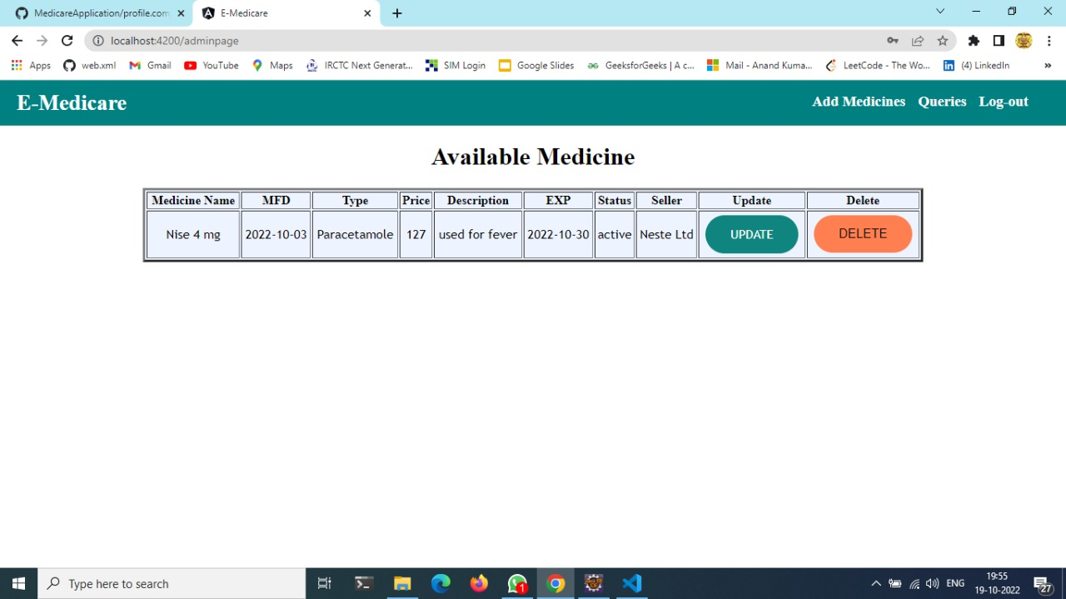
Output Screenshots

Slide 24
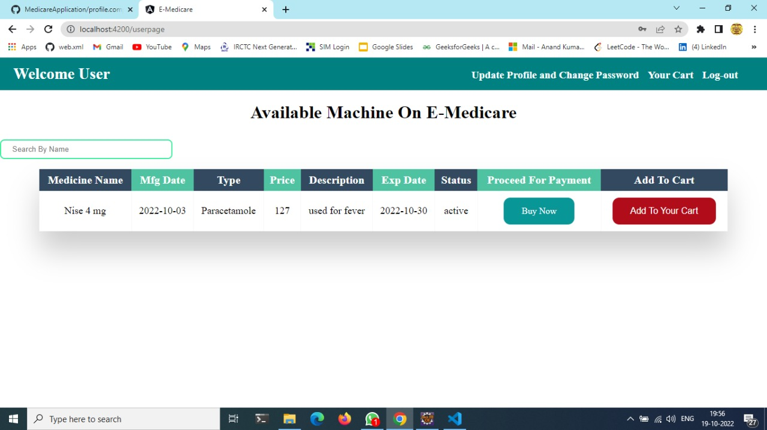
Output Screenshots

Slide 25
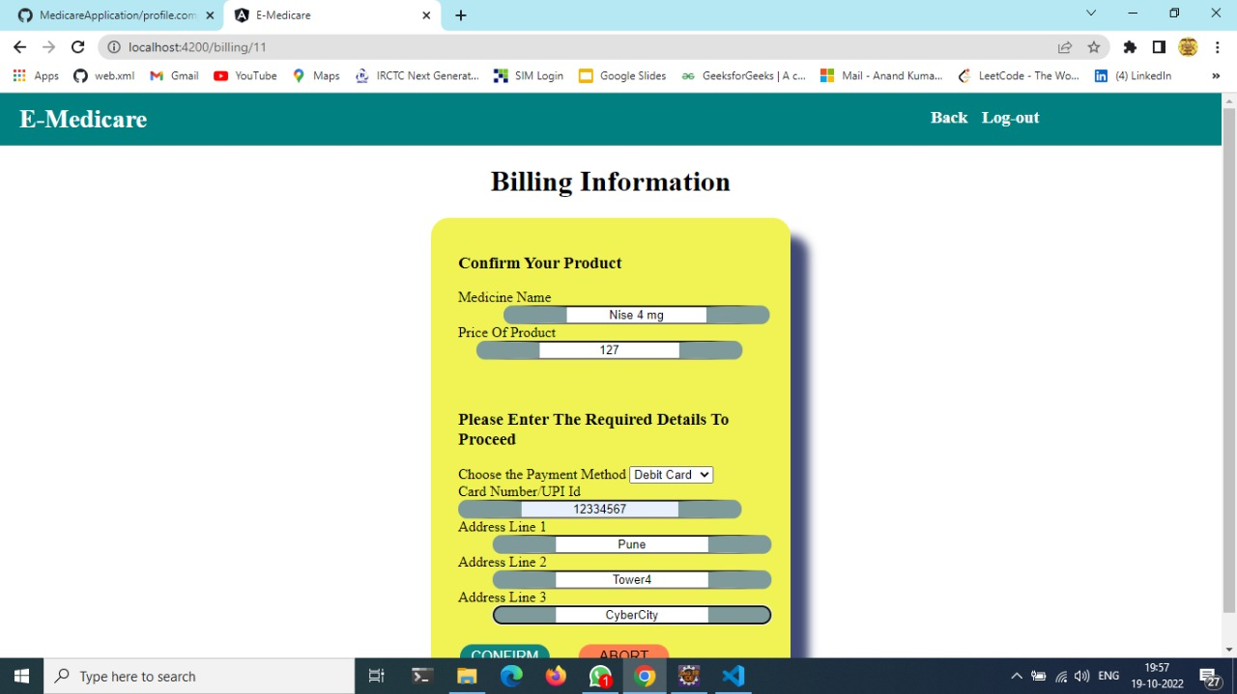
Billing

Slide 26
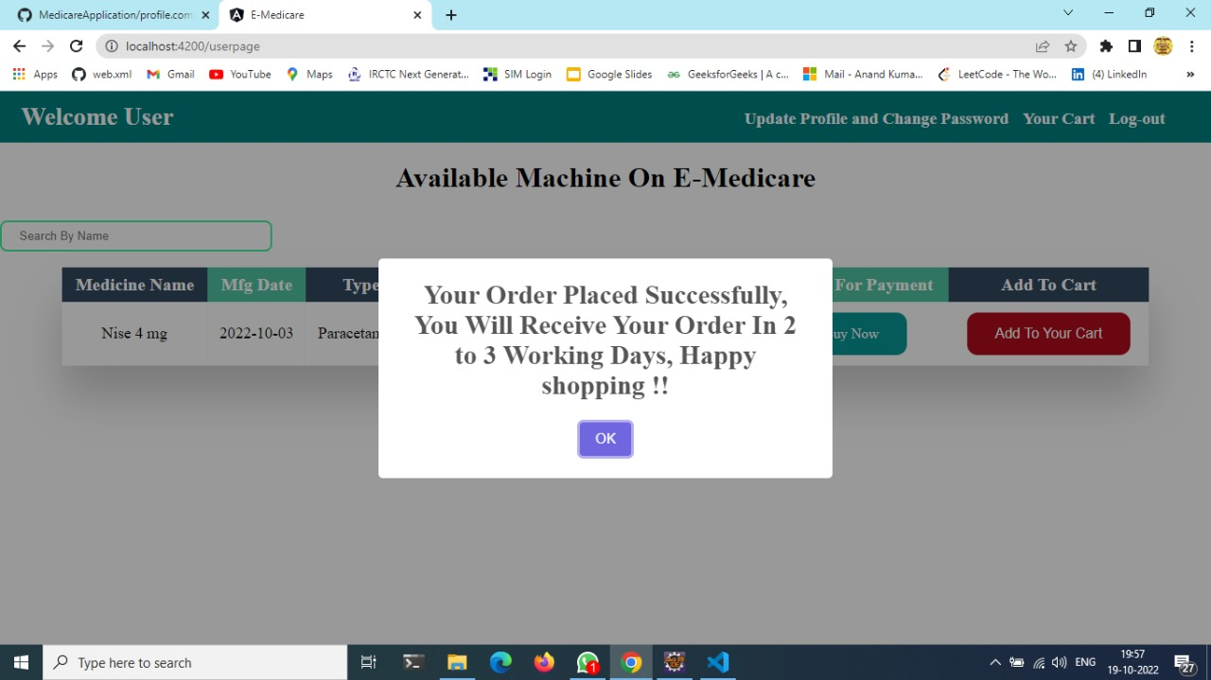
Output Screenshots

Slide 27
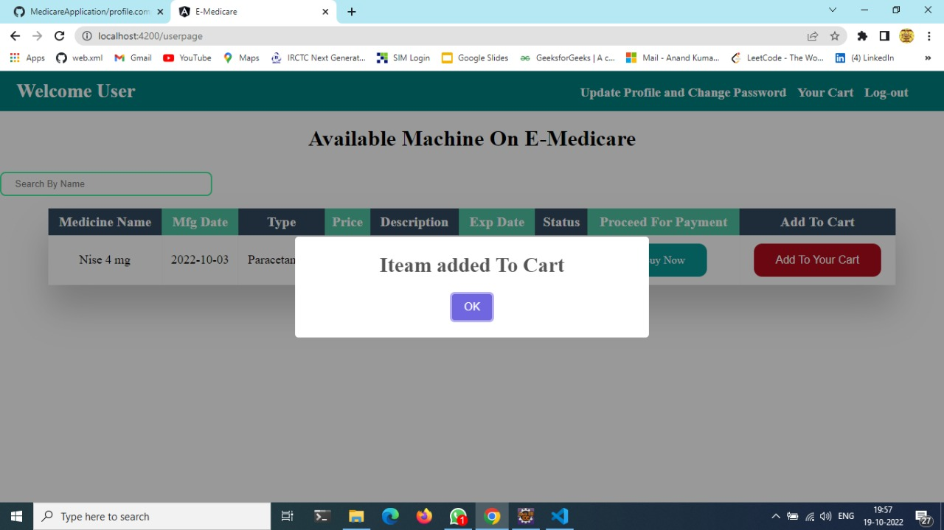
Output Screenshots

Slide 28
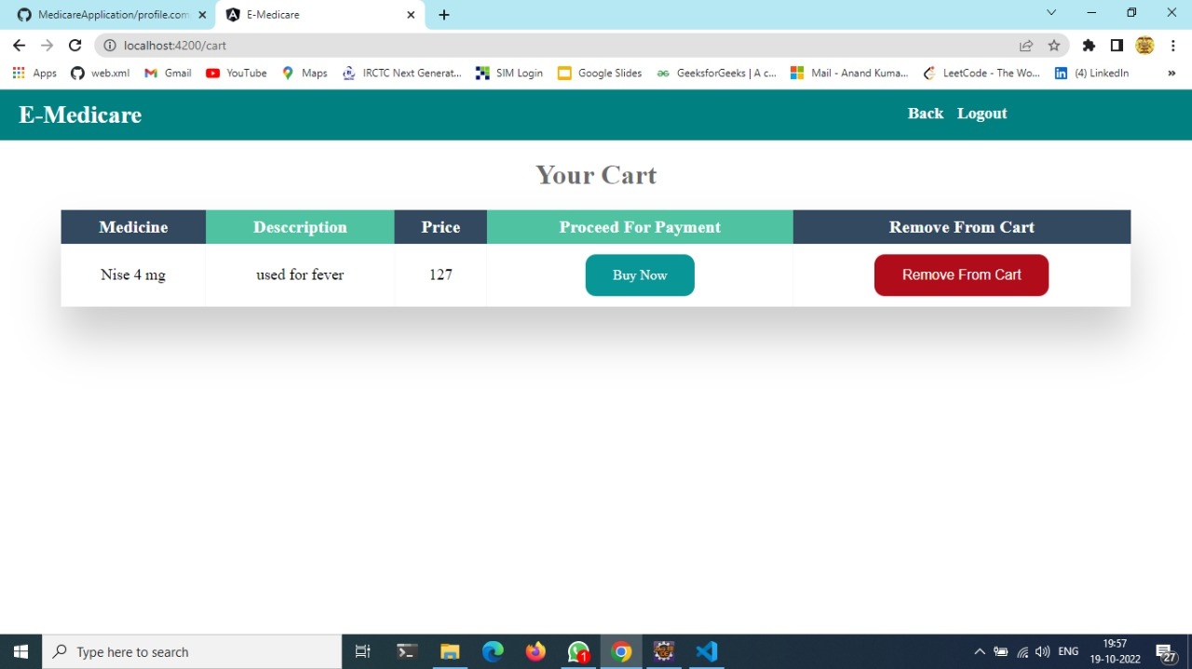
Output Screenshots

Slide 29
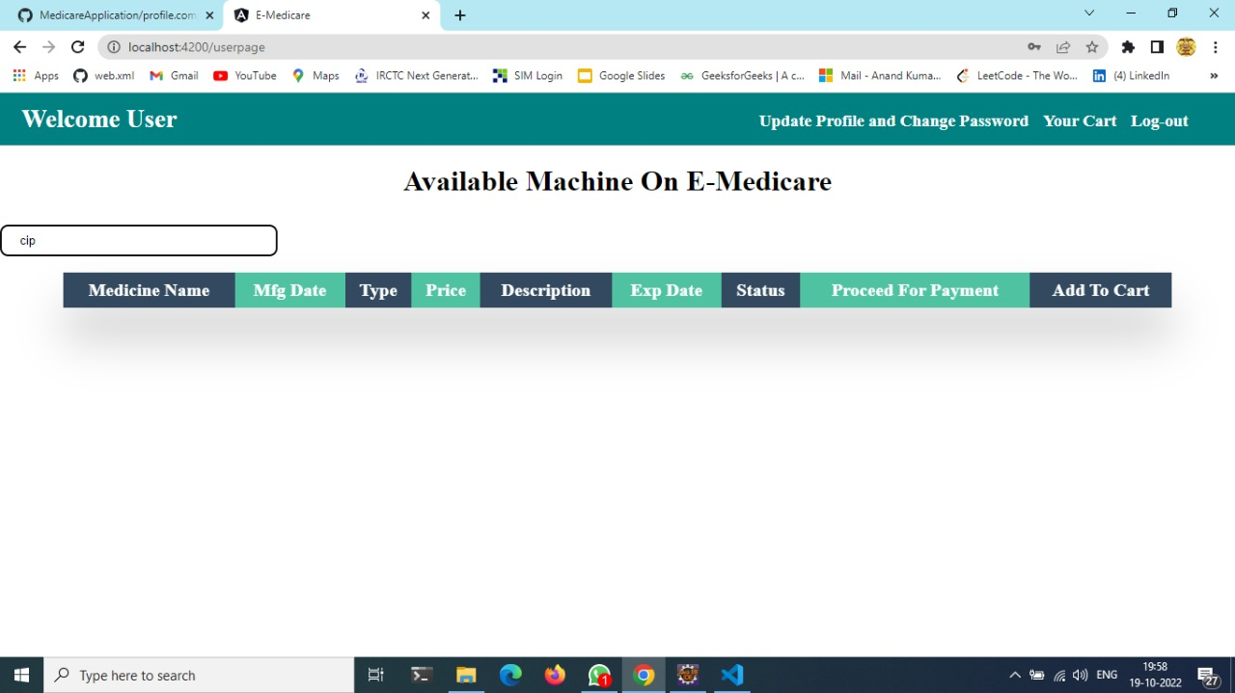
Output Screenshots

Slide 30

Output Screenshots

Slide 31
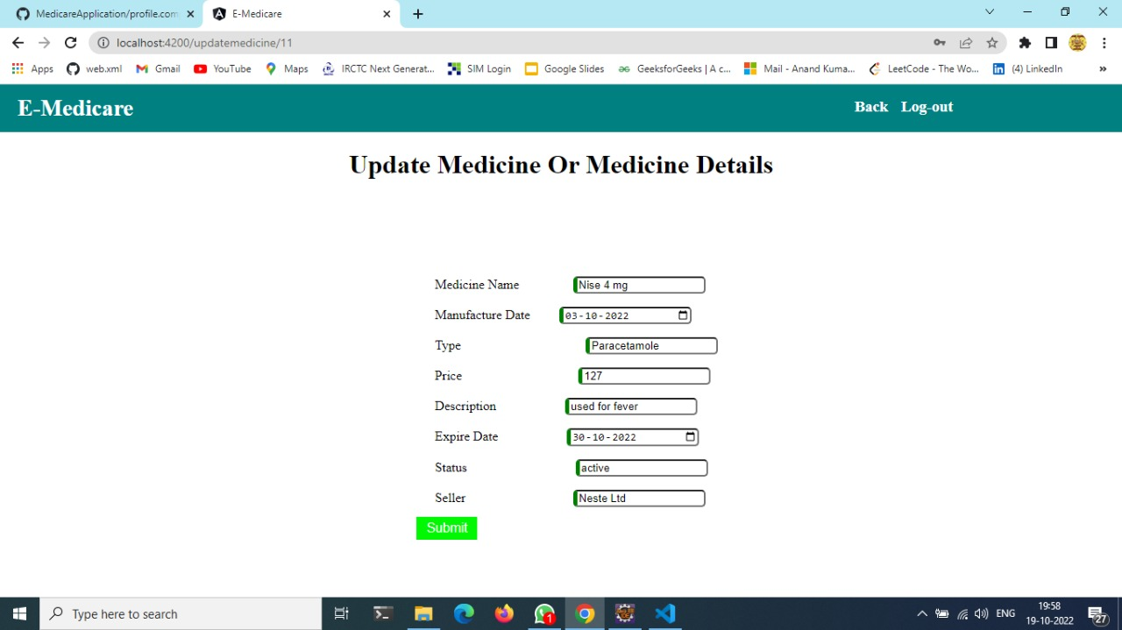
Output Screenshots

Slide 32
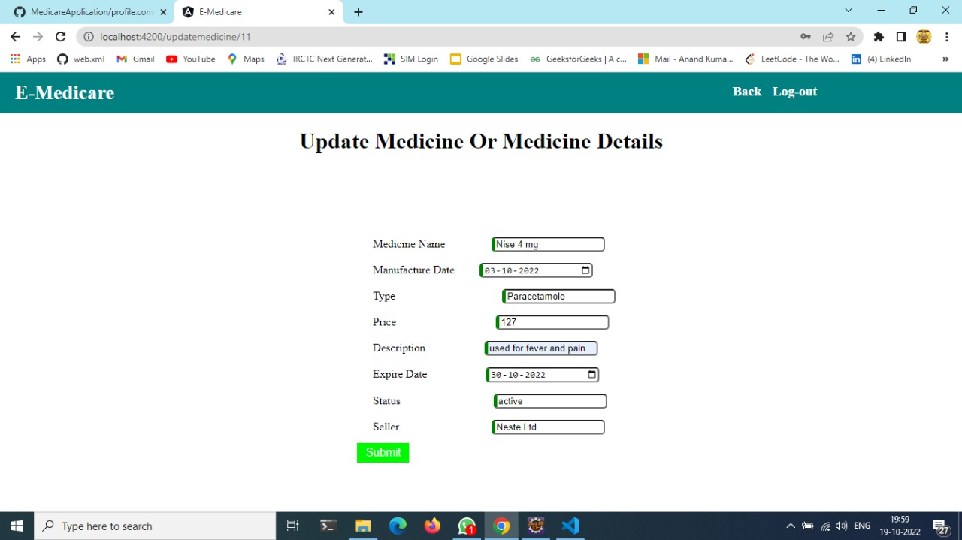
Output Screenshots

Slide 33
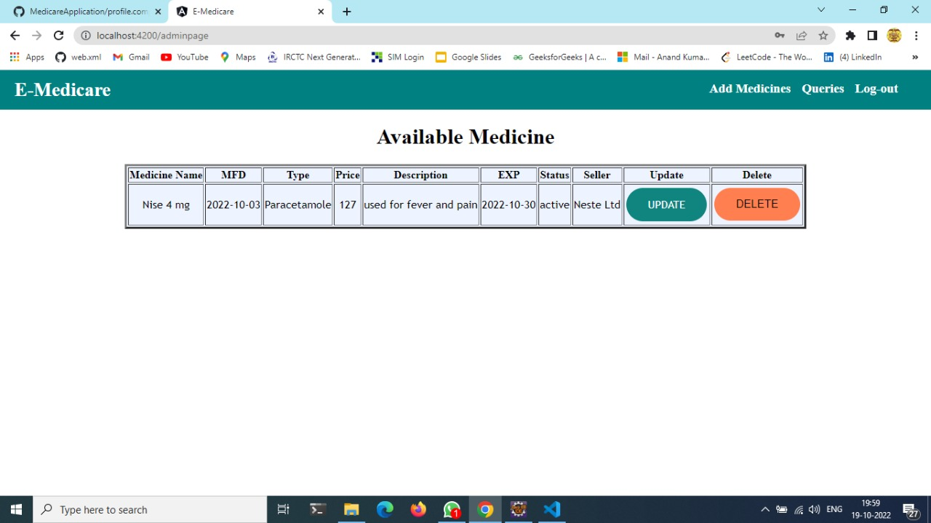
Output Screenshots

Slide 34
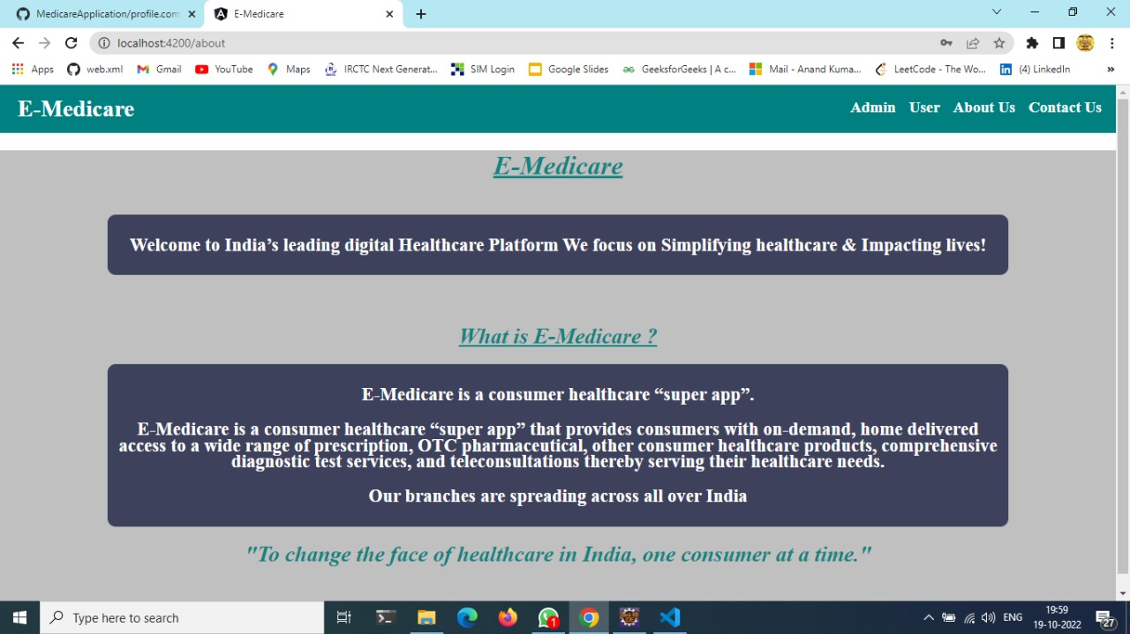
Output Screenshots

Slide 35
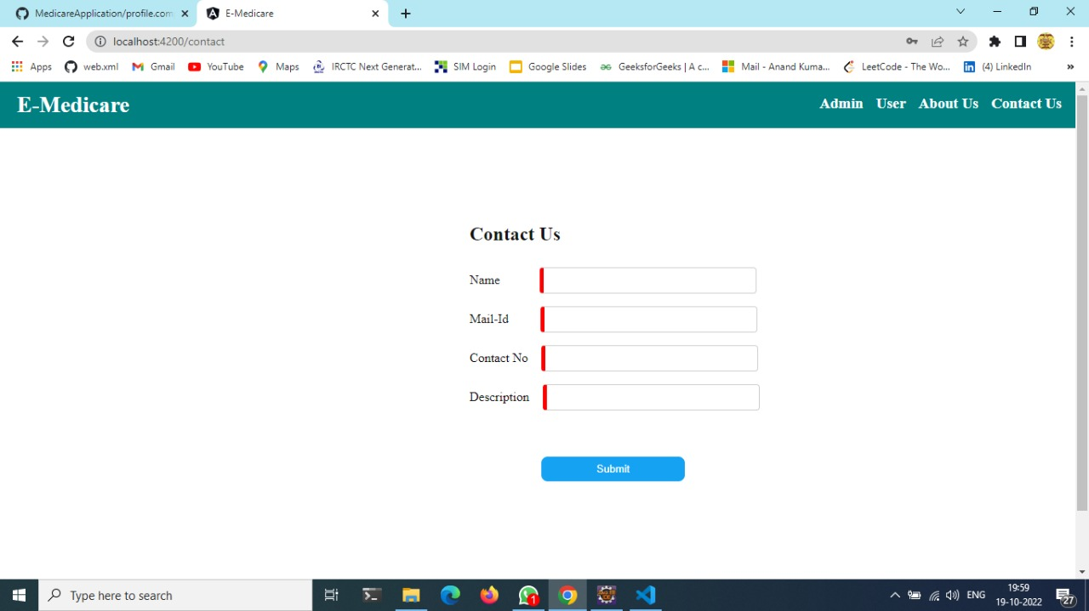
Contact Us

Slide 36
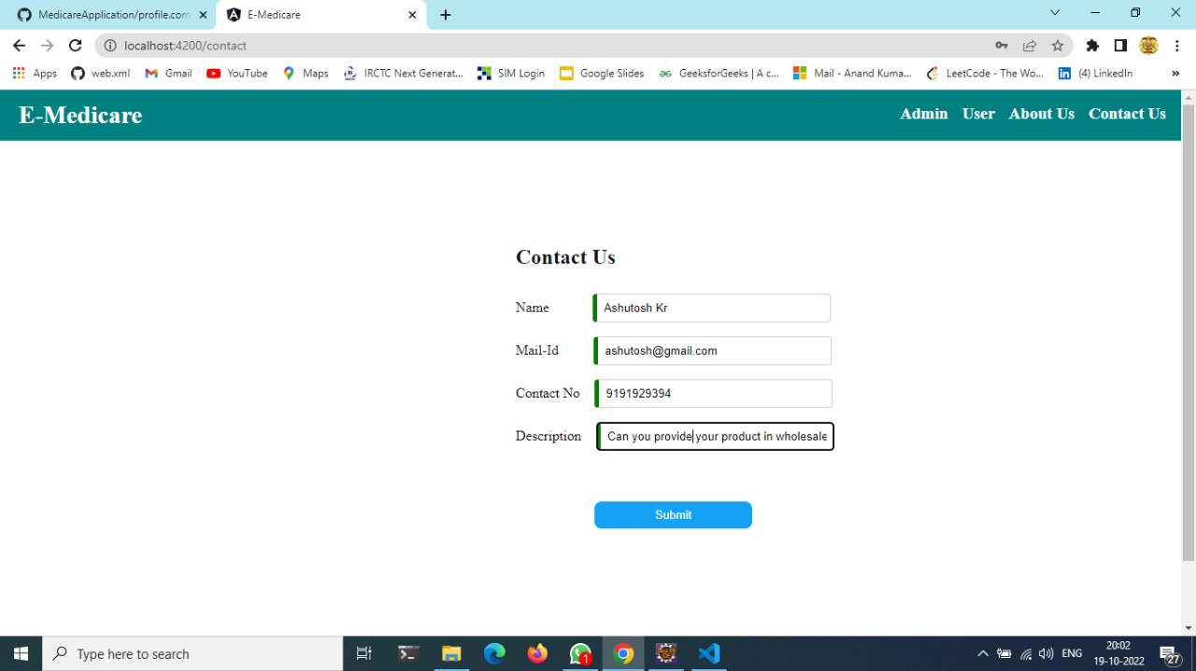
Output Screenshots

Slide 37
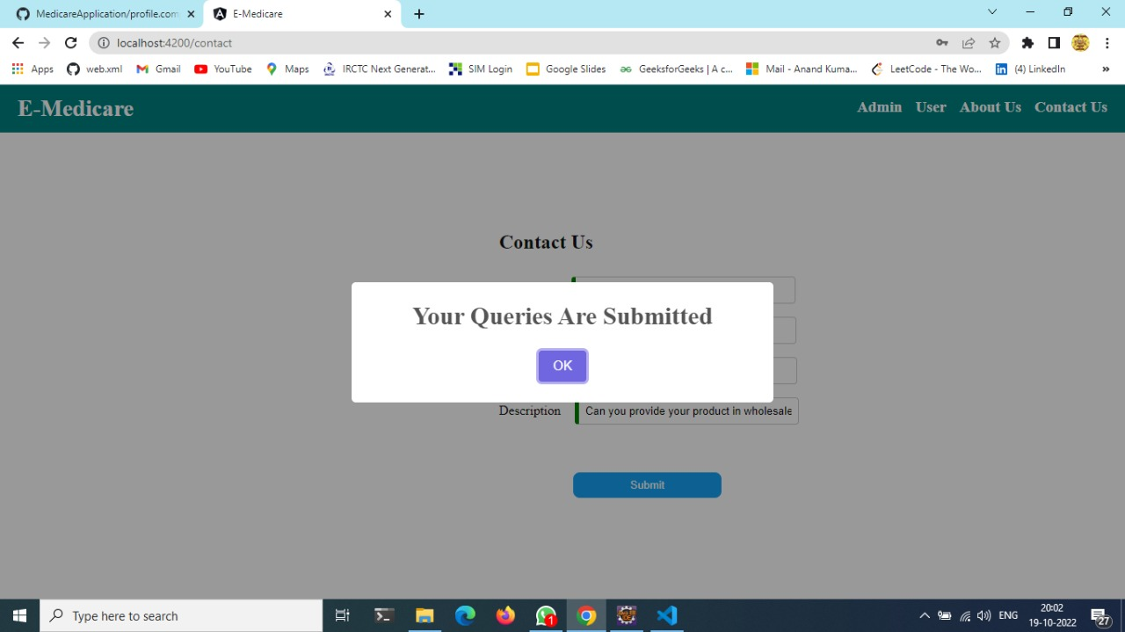
Output Screenshots

Slide 38
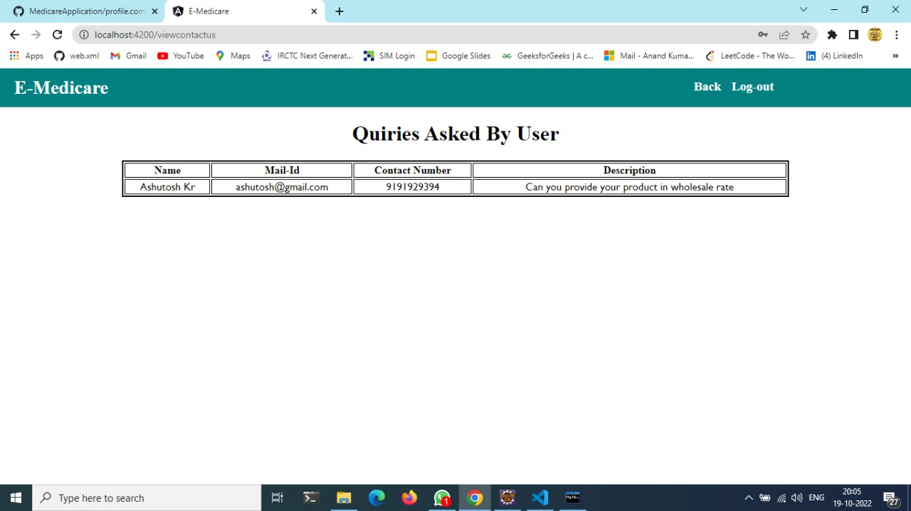
User Queries

Slide 39
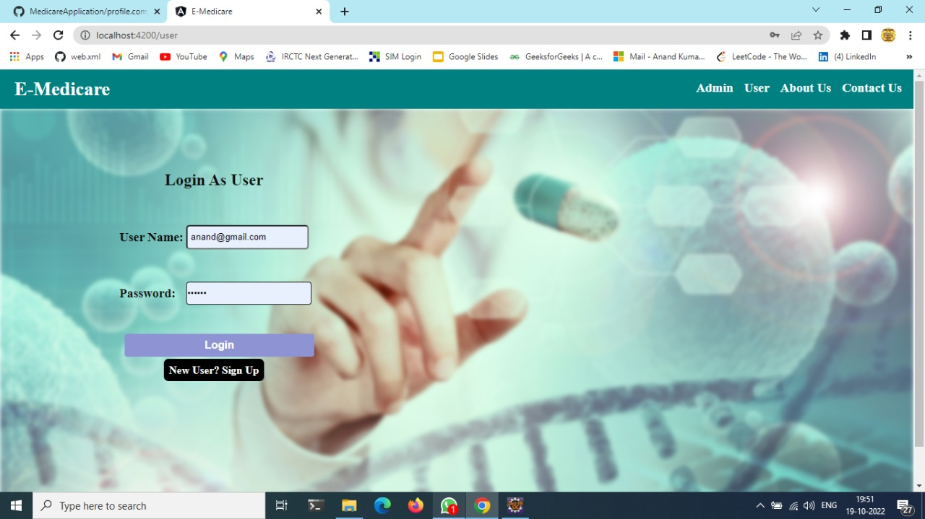
User Login

Slide 40
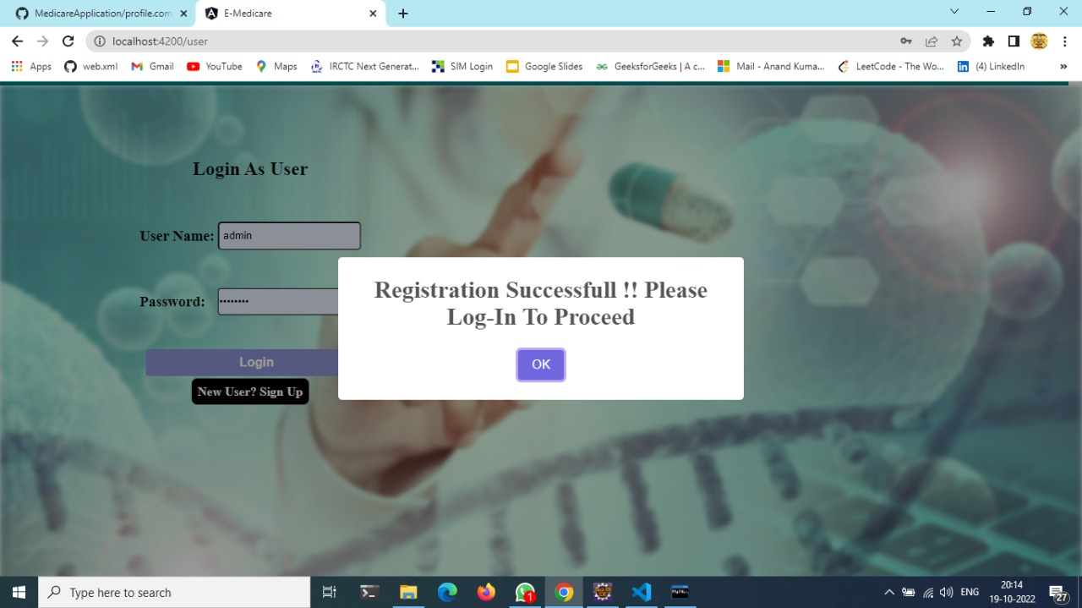
User Login Success

Slide 41
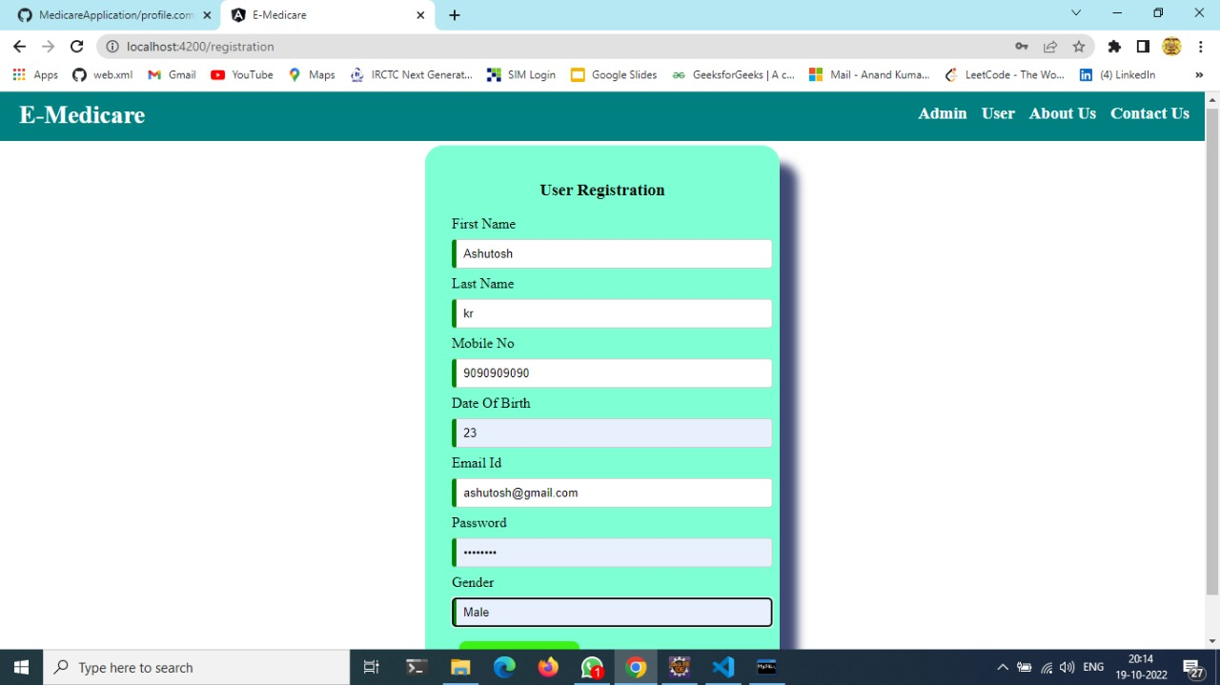
User Registration

Slide 42
Conclusion
Our project is only a humble venture to satisfy the needs to manage their project work. Several user-friendly coding has also adopted. The objective of software planning is to provide a framework that enables the manger to make reasonable estimates made within a limited time frame at the beginning of the software project and should be updated regularly as the project progresses.
At the end it is concluded that we have made effort on following points -
We included features and operations in detail, including screen layouts.
We designed user interface and security issues related to system.
Finally, the system is implemented and tested according to test cases.

Slide 43
Thank You !

